Slide 1
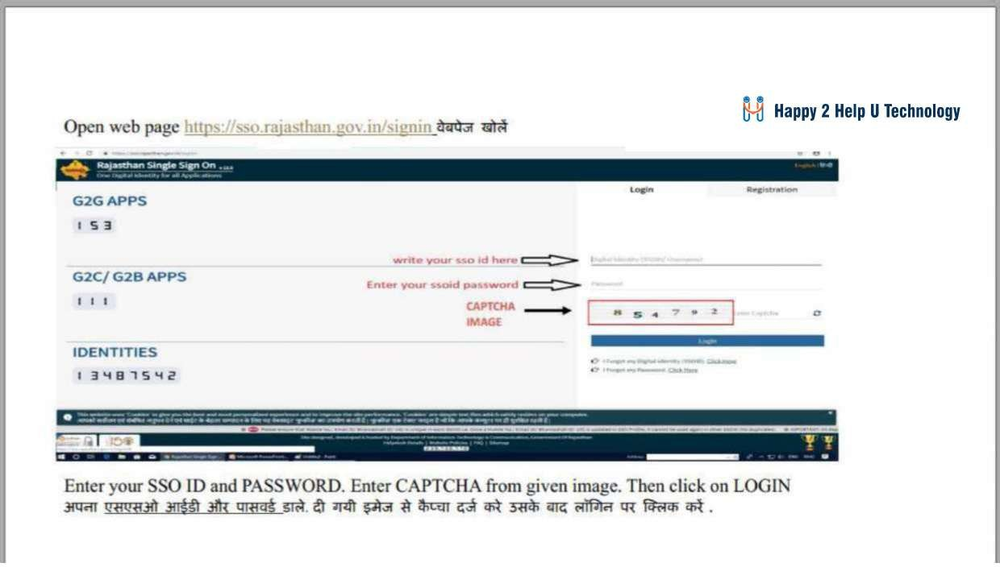
AKSH OPTIFIBRE LTD

Slide 2
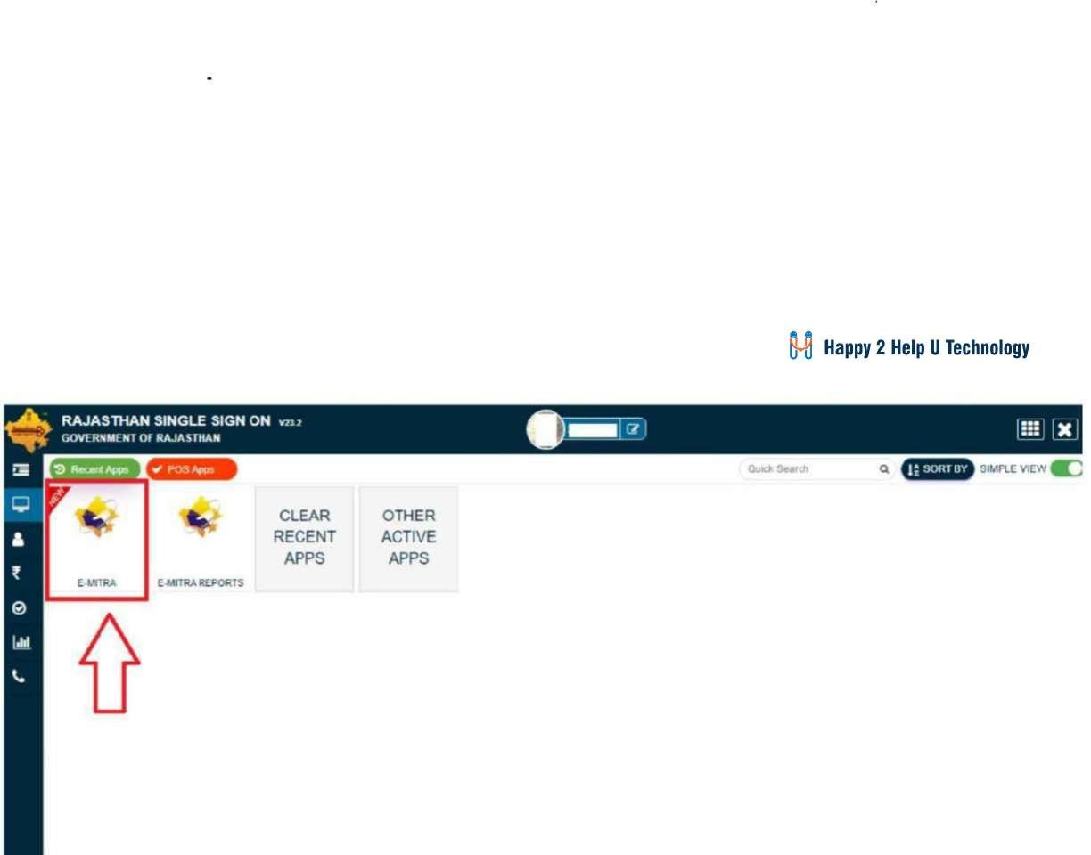
AKSH OPTIFIBRE LTD

Slide 3
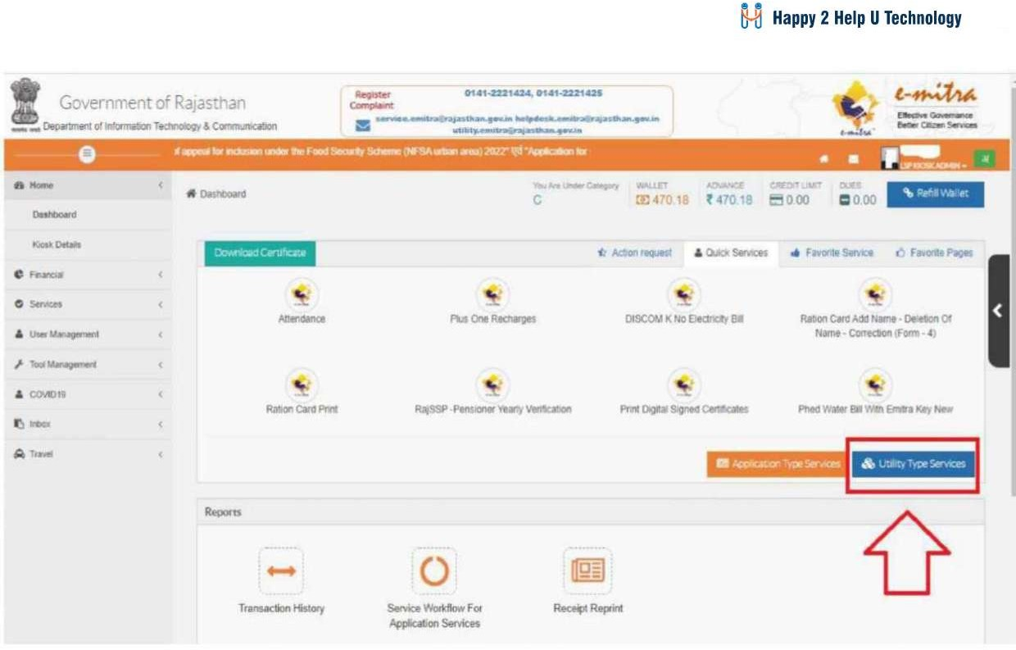
AKSH OPTIFIBRE LTD

Slide 4
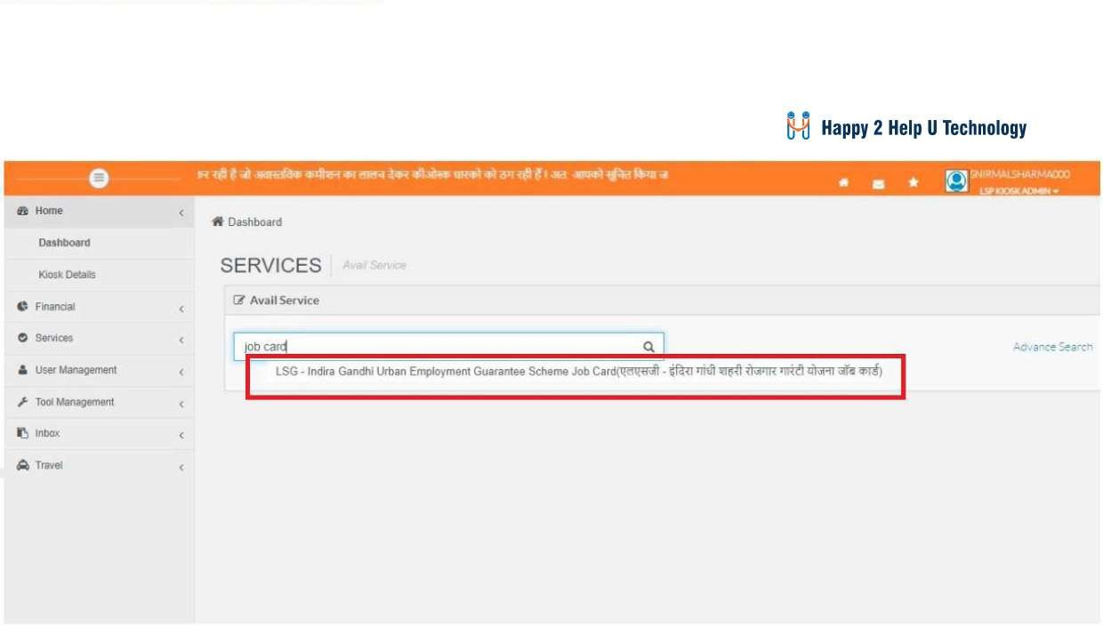
AKSH OPTIFIBRE LTD

Slide 5
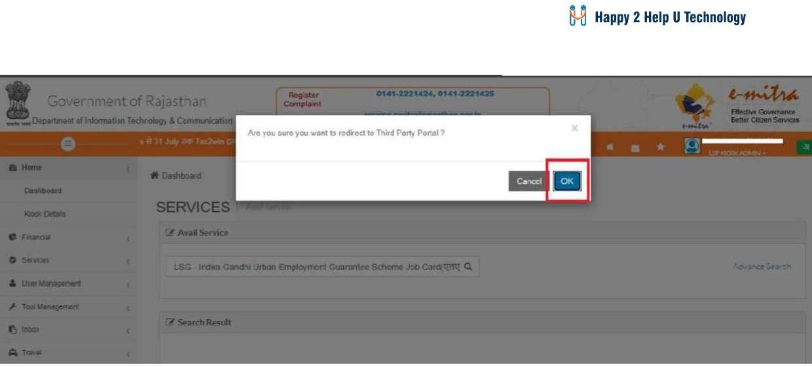
AKSH OPTIFIBRE LTD

Slide 6
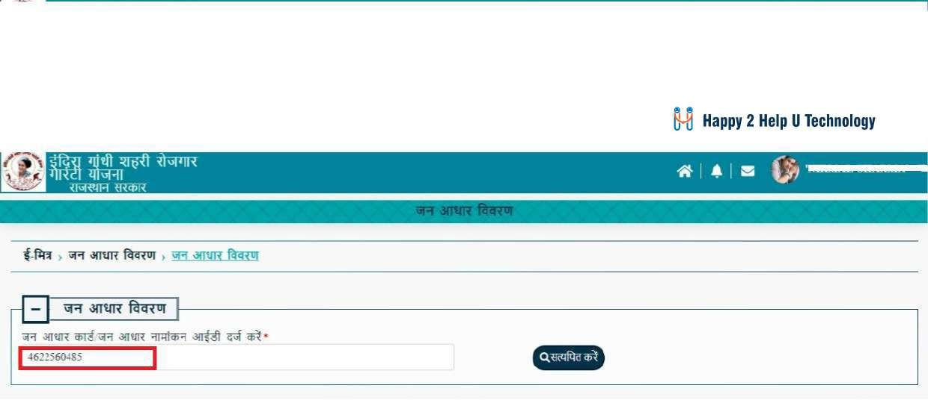
AKSH OPTIFIBRE LTD

Slide 7
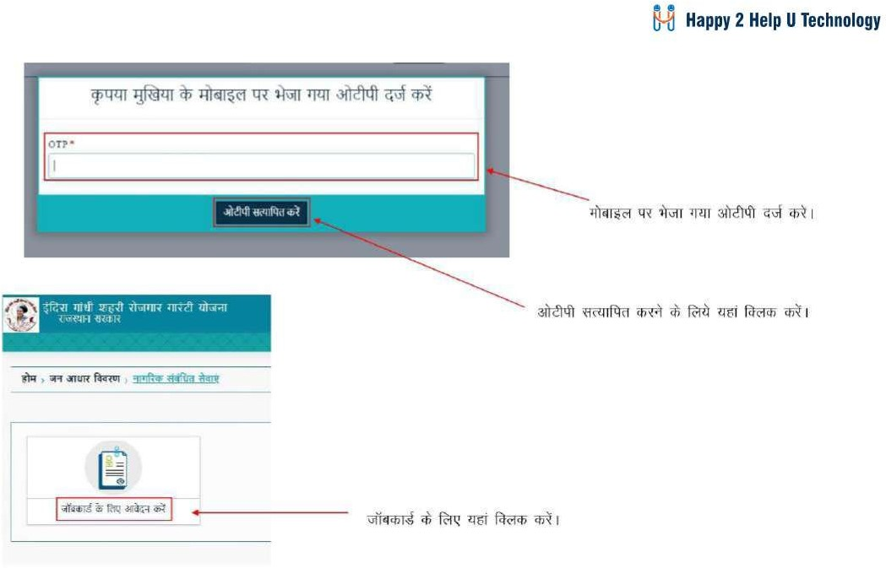
AKSH OPTIFIBRE LTD

Slide 8
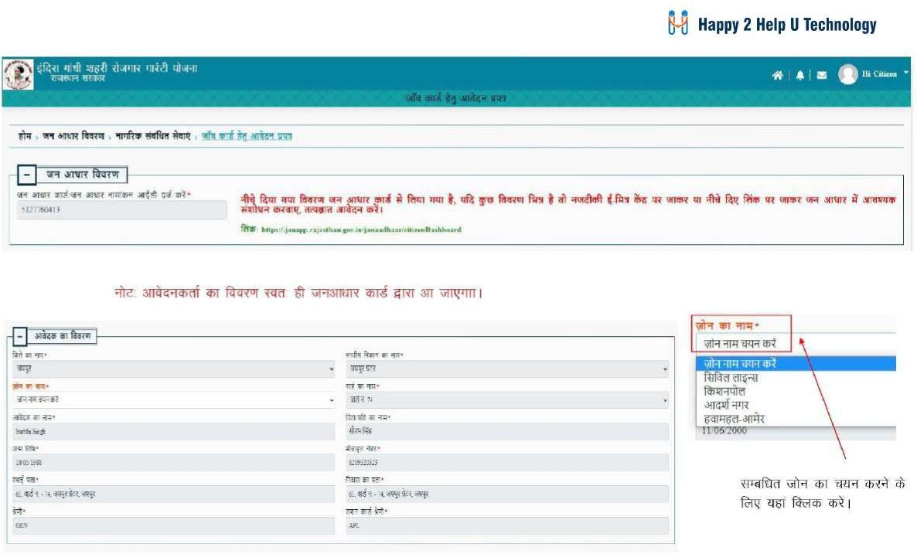
AKSH OPTIFIBRE LTD

Slide 9
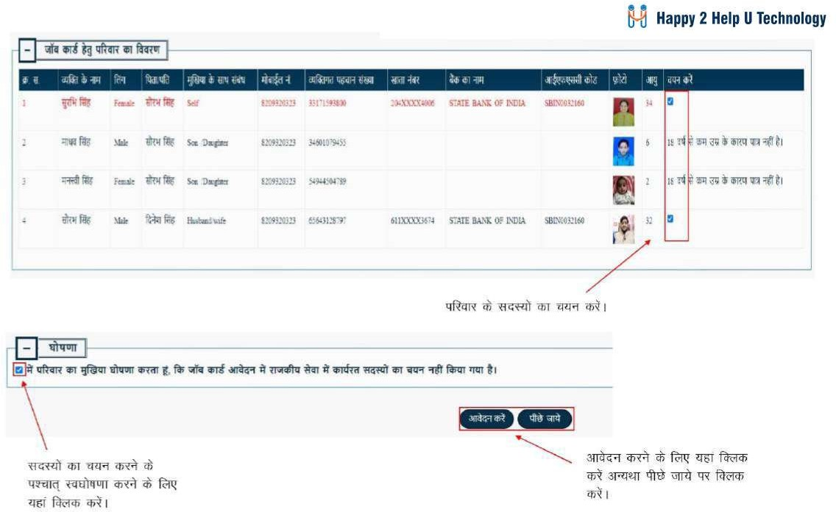
AKSH OPTIFIBRE LTD

Slide 10
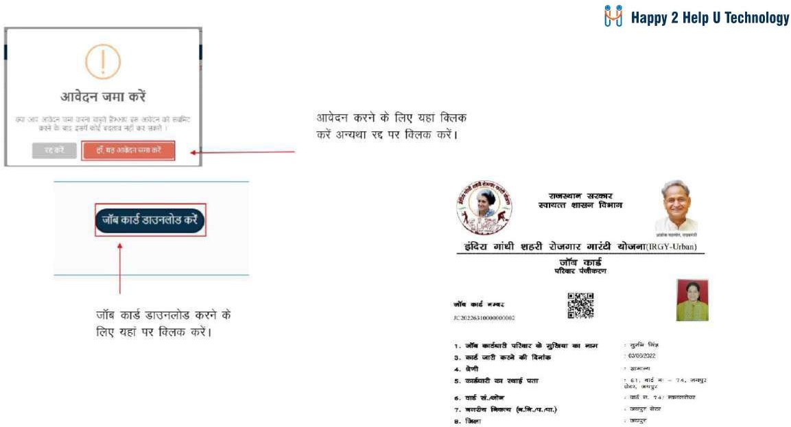
AKSH OPTIFIBRE LTD

Slide 11

Thank You
AKSH OPTIFIBRE LTD
Helpdesk Team
Ph:-0141-2716302,303,304,305,306
Email:-aksh.Rajasthan@akshoptifibre.com

